Slide 1

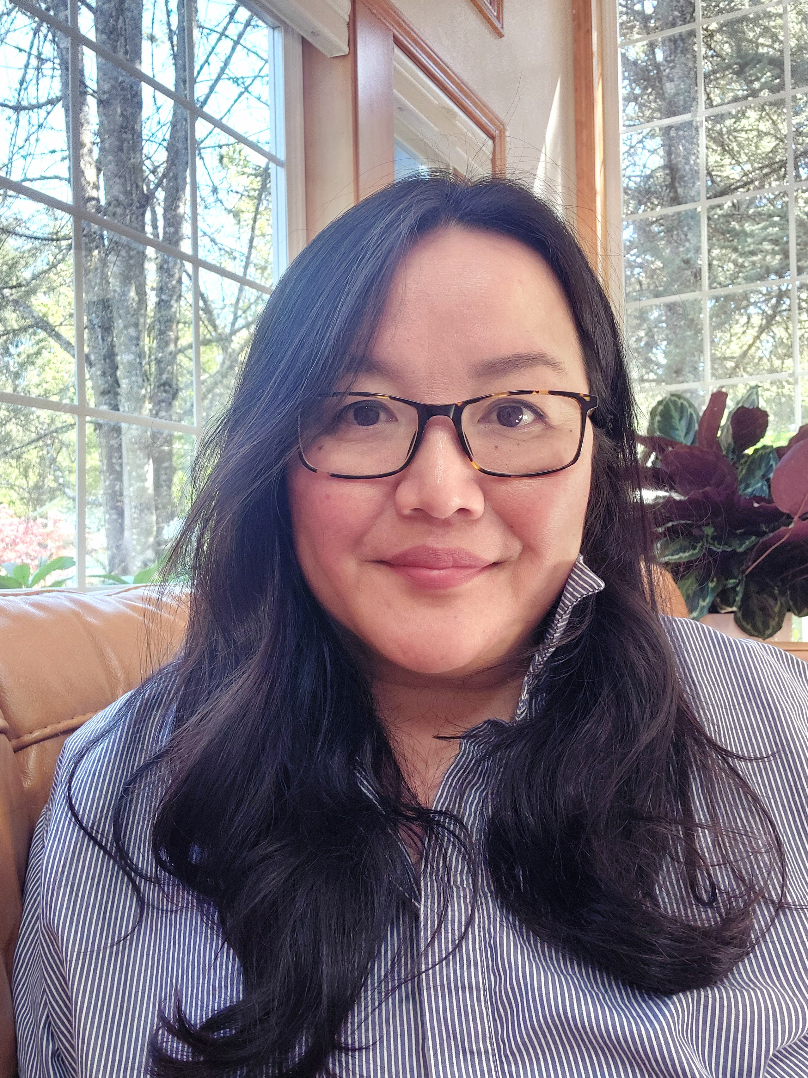

The Legislative equity office
Bor Yang, Legislative Equity Officer
Notes:
Welcome to the State Capitol! Thank you for your service to the Oregon Legislative Assembly. We are very excited to have you here.
My name is Bor Yang and I’m your Legislative Equity Officer.
Legislative leaders work hard to make sure the State Capitol is a safe and welcoming place to visit, work, and volunteer. In fact, this is one of the safest places to work.

Slide 2
The Legislative Assembly’s Policies
Respectful Workplace Policy
Rule 27
To provide a workplace that is safe, respectful, professional and free of inappropriate and disrespectful behavior.
Disrespectful behavior is not based on a person’s protected class status.
Investigated by Employee Services (Human Resources).
To eradicate harassment, discrimination and retaliation in the workplace and legislative business.
Governs behaviors and adverse actions that occur because of someone’s membership in a protected class.
Investigated by LEO or contractor.
Notes:
There are two important policies. The respectful workplace policy and Rule 27. The Respectful Workplace Policy makes sure the State Capitol stays free of inappropriate and disrespectful behavior.
Then there’s the rule that prohibits discrimination, harassment, and retaliation.
The Legislative Equity Office oversees Legislative Rule 27.
Everyone who works in the State Capitol takes a training every year to learn about Rule 27 and become better at stopping discrimination.

Slide 3


DISCRIMINATION
Treating someone differently because of their membership in a protected class.
For example: A manager doesn’t allow a volunteer to do a task because the volunteer appears to have a disability. The manager feels sorry for them. This is discrimination even if the manager means well. The manager is making a decision based on the volunteer’s disability.
Notes:
What is Discrimination?
Discrimination happens when someone is treated differently because of their membership in a protected class.
By the way, discrimination doesn’t always look how you might expect. People might have disabilities that you can’t identify by looking at them. They’re protected too. People who don’t believe in a God are protected from religious discrimination in the same way that people who practice a religion are.

Slide 4
Protected Classes
Sex
Race
Ethnicity
Age
National origin
Religion
Marital Status
Sexual orientation
Gender identity or expression
Engaging in whistleblowing activity
Opposing employer’s actions when believed to be unlawful
Taking Leave
Injured Worker’s Status
Disability
Veteran Status
Notes:
A protected class is a category of individuals who are protected from discrimination. Race, ethnicity, national origin, religion, age, disability, sex, gender identity, gender expression, and sexual orientation and more are all types of protected classes.
We all belong to multiple protected classes. Which ones apply to you?

Slide 5
Harassment
Unwelcome behavior that targets someone because of their protected class status.
Interferes with work performance or creates an intimidating, hostile or offensive work environment.
and
Notes:
Harassment is a form of discrimination. It happens when the work environment is abusive or hostile for someone because they’re part of a protected class.
Notice that harassment is similar to bullying. The important difference is that bullying is unwanted disrespectful behavior that happens repeatedly but NOT because of someone’s membership in a protected class.
Both bullying and harassment are not permitted at the State Capitol.

Slide 6

Examples of INAPPROPRIATE BEHAVIOR
Shouting at someone.
Making fun of someone’s intelligence in front of others.
Starting or spreading rumors.
Sharing information about someone with the intent to embarrass them.
Texting or direct messaging an insult.
Posting insulting language about someone on social media.

Slide 7
Examples of Sexual Harassment
Unwelcome conduct of a sexual nature, includes and is not limited to:
Unwanted jokes or comments about someone’s body
Touching someone’s body without their permission
Whistling at someone
Making obscene comments or gestures
Taking, showing or sharing inappropriate pictures or videos
Not respecting someone’s right to say no
Notes:
Another serious form of harassment is sexual harassment — which can include unwelcome jokes or comments about someone’s body, touching someone’s body without their permission, whistling at someone, making obscene comments or gestures, or taking, showing, or sharing inappropriate pictures or videos.
Did you know that asking someone to go out with you repeatedly could be sexual harassment? Not respecting a person’s right to say no or set boundaries might be considered harassment, even if you mean well.

Slide 8

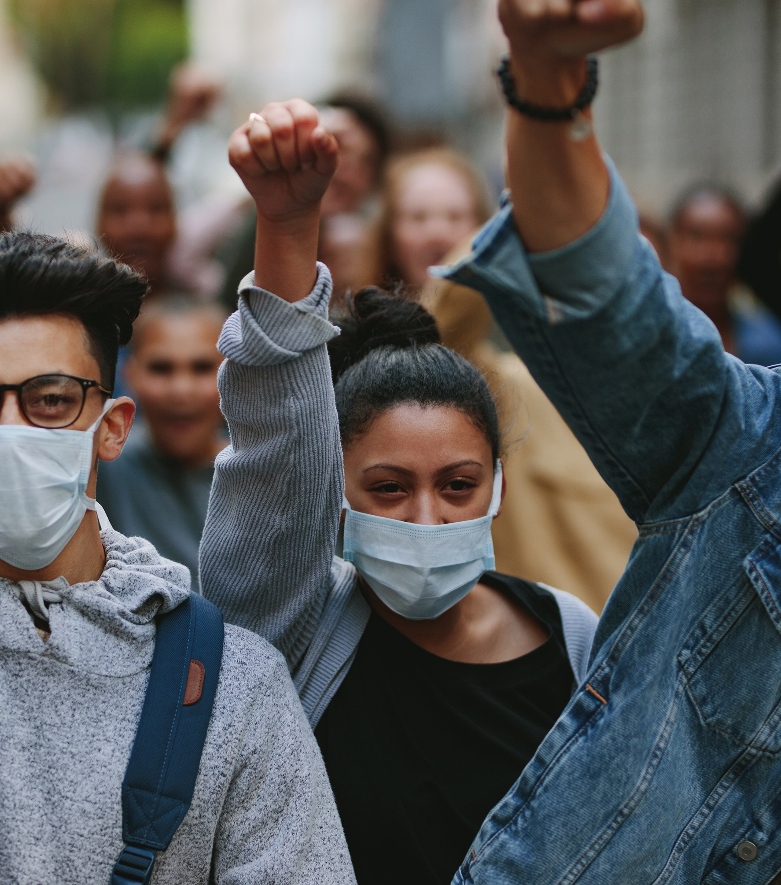


Differences
Uncomfortable or offensive comments does not equal harassment or discrimination but they still matter. You matter.
Notes:
We live in a world of differences, and that means we all have to deal with uncomfortable experiences. Not all of those experiences are discrimination or harassment, but they still matter.
For example, it might feel bad to be excluded from a friendship group or to hear from your supervisor that you’re not doing a good job.
In the State Capitol, you might hear people talking openly about difficult and controversial topics. They might be passionate about their positions. They might even get loud and say unkind things to express themselves.
Situations like this can be hurtful, but if they’re not related to a protected class, they’re not discrimination. The good news is you don’t have to know that something is discrimination or harassment to report it.

Slide 9
What can I do? Report…
Disrespectful Behavior
Harassment
Discrimination
Retaliation
Notes:
If something makes you feel upset, uncomfortable, unsafe, or unwelcomed, please report it to an adult in the State Capitol or the Legislative Equity Office or Human Resources or your supervisor or manager. Even if you haven’t experienced discrimination, we want to know what you’re experiencing so we can help make the capitol a safer and more welcoming place.
You don’t need to be the target of the behavior to report it. You can report things you’ve observed or heard about, and you can ask a parent or someone you trust to help you report something or to report it for you.

Slide 10
retaliation
The laws and rule protect you from retaliation.
This means that you cannot be punished or treated unfairly because you reported discrimination or harassment or participated in an investigation.
.
Notes:
And

Slide 11
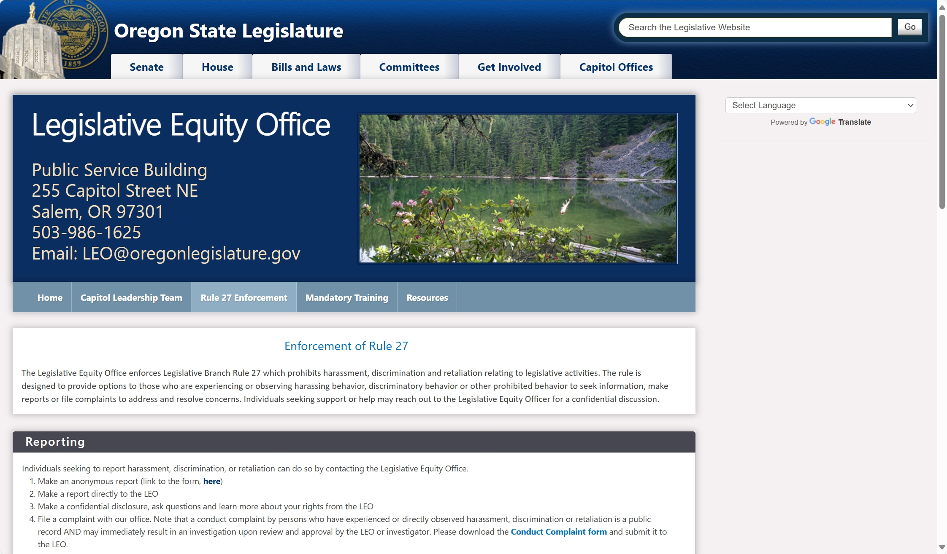

confidentiality
Anonymous & Confidential
Notes:
You can make an anonymous report to the Legislative Equity Officer by going to our website. www.oregonlegislature.gov/leo
You can simply google: Oregon Legislative equity office.
You, or someone acting on your behalf, can speak to the Legislative Equity Office confidentially. That means whatever you share won’t be shared with anyone else without your permission. The Legislative Equity Officer is here to give you helpful information, to walk you through different options, and to support you.

Slide 12

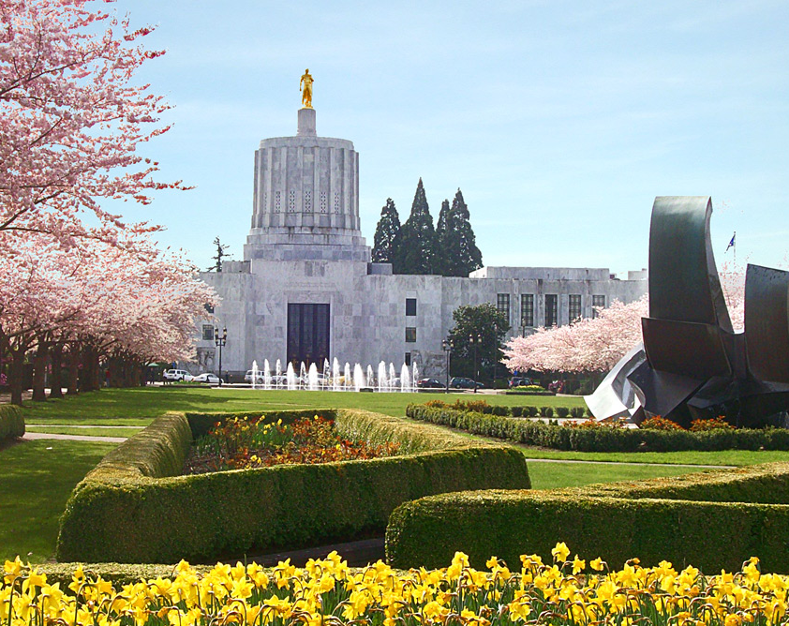
Why Report?
When you report a case of discrimination or harassment, it requires others to act. It might stop harm from happening now and in the future.
The Legislative Equity Officer can put together a plan to protect the person who is being harmed. They can create trainings and programs that teach others what not to do.
When you make a report, you help the leaders learn more about safety in the State Capitol and give them the information they need to make important changes to Rule 27 and to capitol practices.
Notes:
When you report a case of discrimination or harassment, it requires others to act. It might stop harm from happening now and in the future.
The Legislative Equity Officer can put together a plan to protect the person who is being harmed. They can create trainings and programs that teach others what not to do.
When you make a report, you help the leaders learn more about safety in the State Capitol and give them the information they need to make important changes to Rule 27 and to capitol practices.

Slide 13
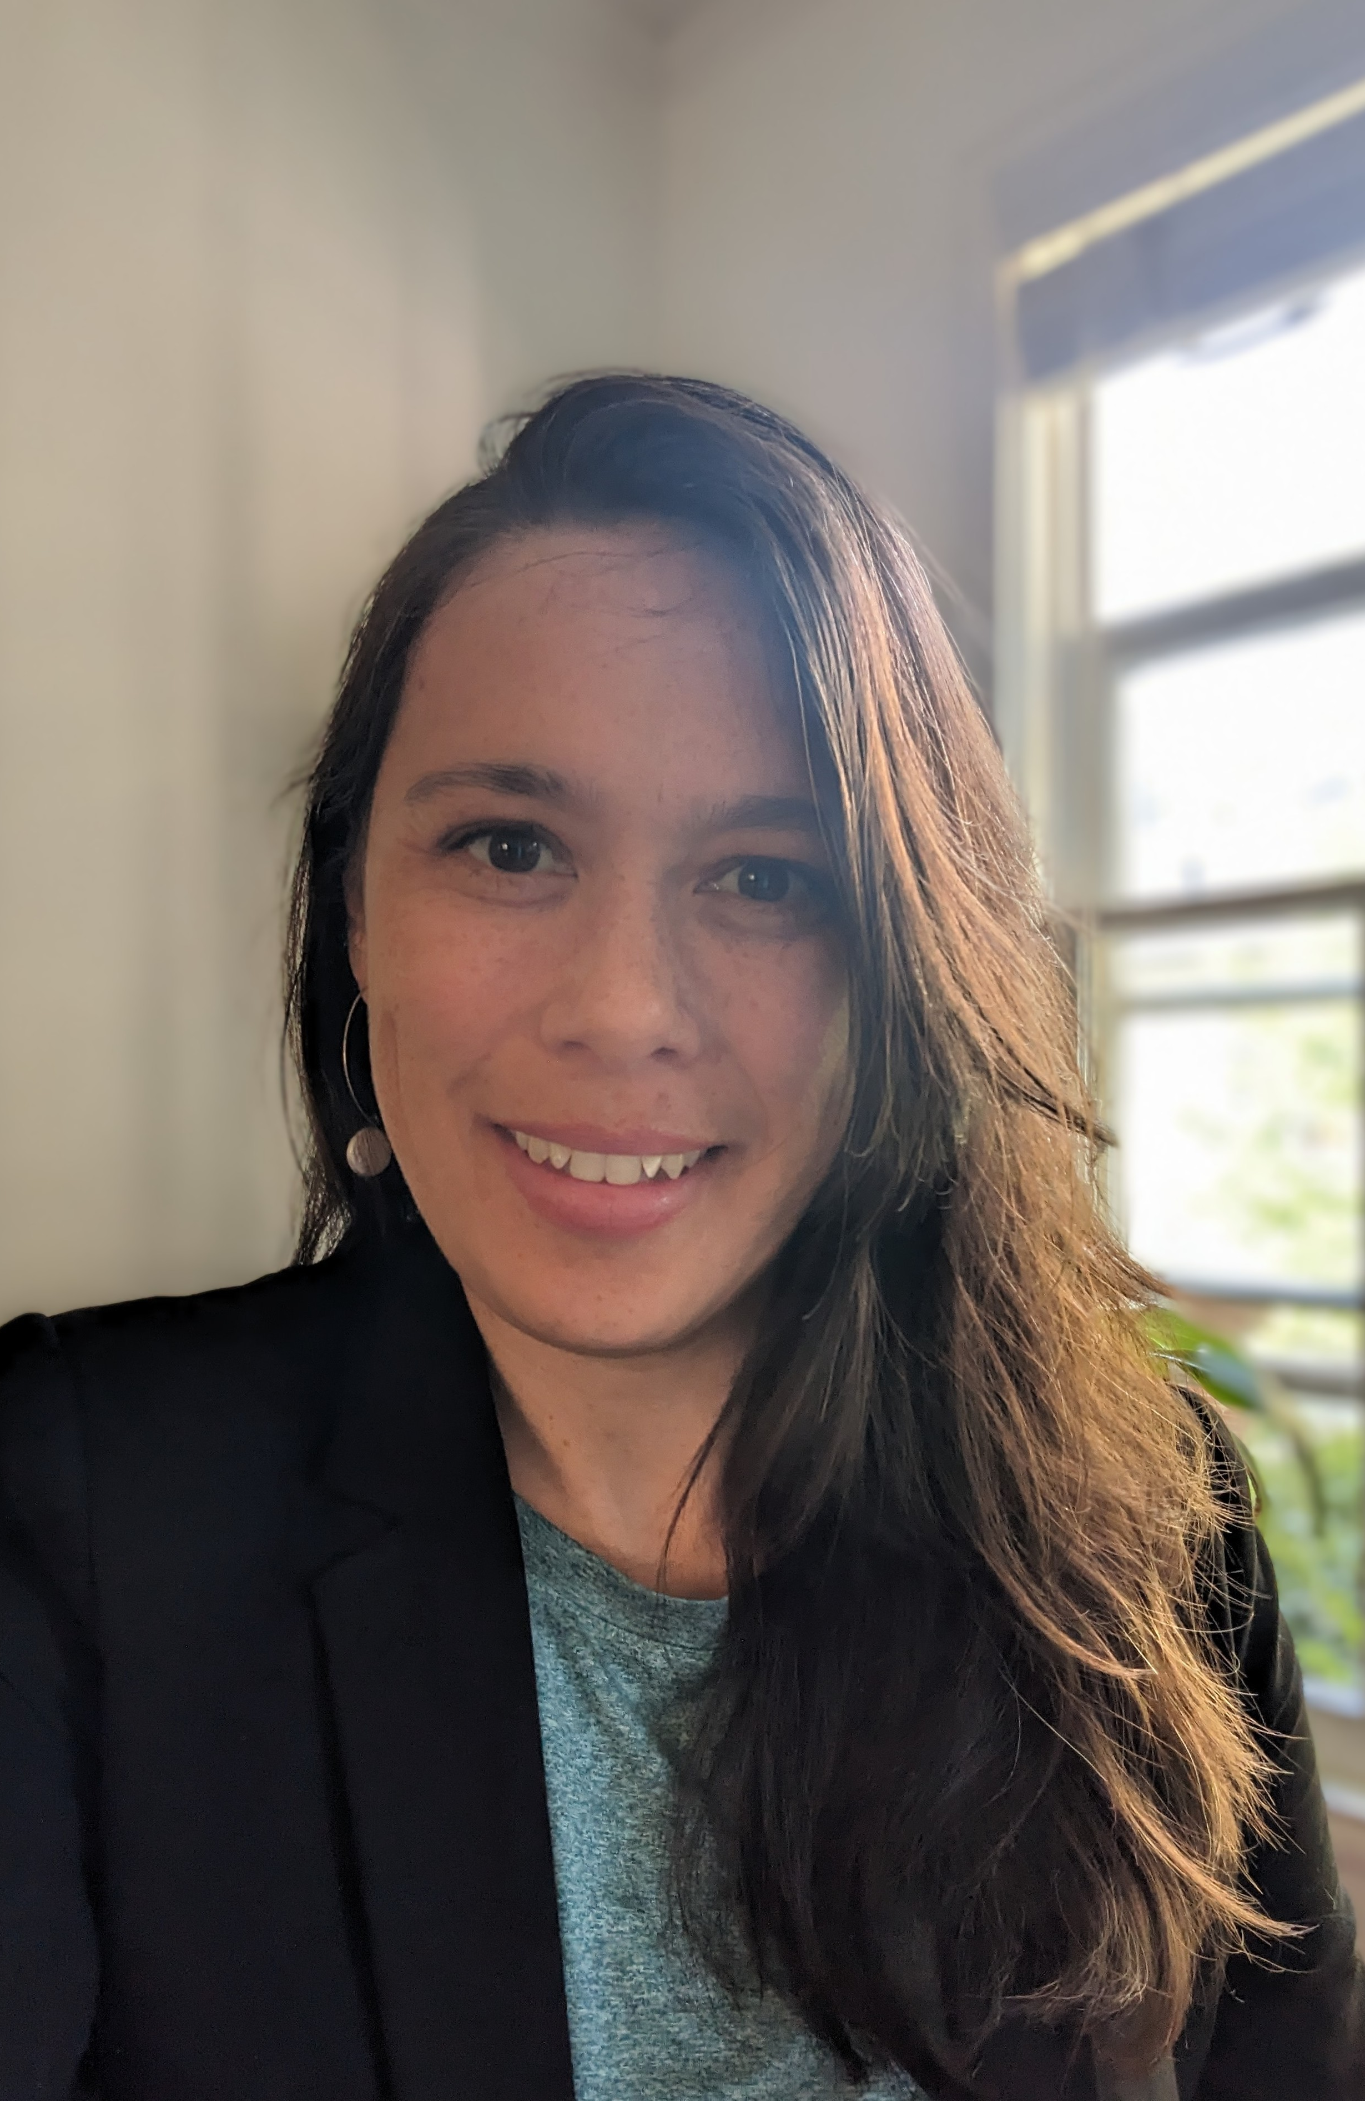
THANK YOU! we have walk in hours and we’re happy to meet outside of work hours in person or remotely by appointment.
Email us: LEO@oregonlegislature.gov
Call us: 503-986-1625
Aislyn Matias
LEO Support Specialist
Visit us: Public Service Building, First Floor 255 Capitol Street NE Salem, OR 97301
Notes:
You have a very important role to play in making the State Capitol a safe and welcoming place to work. This includes keeping your hands to yourself and not using any profanity or name-calling. Be kind, strive to be your best self, and expect the same of others. Show respect to yourself, and to those around you in this very important place.
Thank you again for your service. We’re so glad to have you here.
This is a message brought to you by the Legislative Equity Office. Learn more about us at oregonlegislature.gov/leo.

