Slide 1

AORTA
Association of Oregon Rail and Transit Advocates

Slide 2
Jon Nuxoll,
Eugene,
President
Matt Krabacher,
Baker City,
Eastern Oregon Vice President

Slide 3
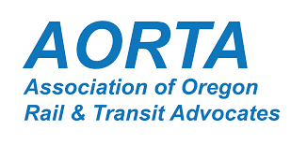
Funding Passenger Rail
Current funding
  Lawn Mower Gas Tax
Notes:
Good news: stable Bad news: Not enough to expand

Slide 4
Funding Passenger Rail
Current funding
  Lawn Mower Gas Tax
Payroll transit tax (STIP)
  0.1 percent for transit (rail and bus)
Notes:
Good news: stable Bad news: Not enough to expand

Slide 5
Funding Passenger Rail
Current funding
  Lawn Mower Gas Tax
Payroll transit tax (STIP)
  0.1 percent for transit (rail and bus)
Gas/Transportation Tax
  Penny for rail and transit
  1 KwH for rail and transit
Notes:
Good news: stable Bad news: Not enough to expand

Slide 6
Funding Passenger Rail
Current funding
  Lawn Mower Gas Tax
Payroll transit tax (STIP)
  0.1 percent for transit (rail and bus)
Gas/Transportation Tax
  Penny for rail and transit
  1 KwH for rail and transit
Tax Credits
  Freight rail expansion
Notes:
Good news: stable Bad news: Not enough to expand

Slide 7
Funding Passenger Rail
Current funding
  Lawn Mower Gas Tax
Payroll transit tax (STIP)
  0.1 percent for transit (rail and bus)
Gas/Transportation Tax
  Penny for rail and transit
  1 KwH for rail and transit
Tax Credits
  Freight rail expansion
ConnectOregon
  Application criteria
Notes:
Good news: stable Bad news: Not enough to expand

Slide 8
Funding Passenger Rail
Current funding
  Lawn Mower Gas Tax
Payroll transit tax (STIP)
  0.1 percent for transit (rail and bus)
Gas/Transportation Tax
  Penny for rail and transit
  1 KwH for rail and transit
Tax Credits
  Freight rail expansion
ConnectOregon
  Application criteria
Colorado’s $50 million
  $3 rental-car fee (SB24-184)
Notes:
Good news: stable Bad news: Not enough to expand

Slide 9
Rail Planning
Interstate:
  Southern Rail Authority
  Northern New England Passenger Rail Authority
  Twin Cities-Milwaukee-Chicago Intercity Passenger Rail Project
Intrastate
  Big Sky Passenger Rail Authority (Montana)
  Front Range Passenger Rail District (Colorado)
Notes:
Good news: stable Bad news: Not enough to expand

Slide 10
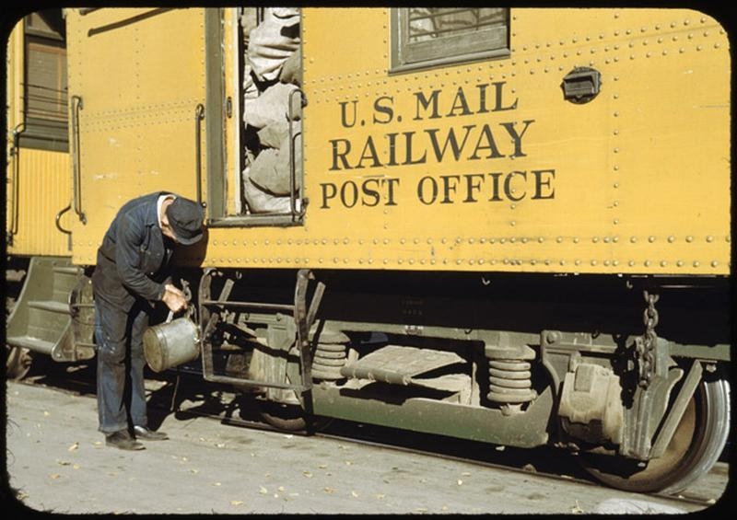
Who pays?

Slide 11
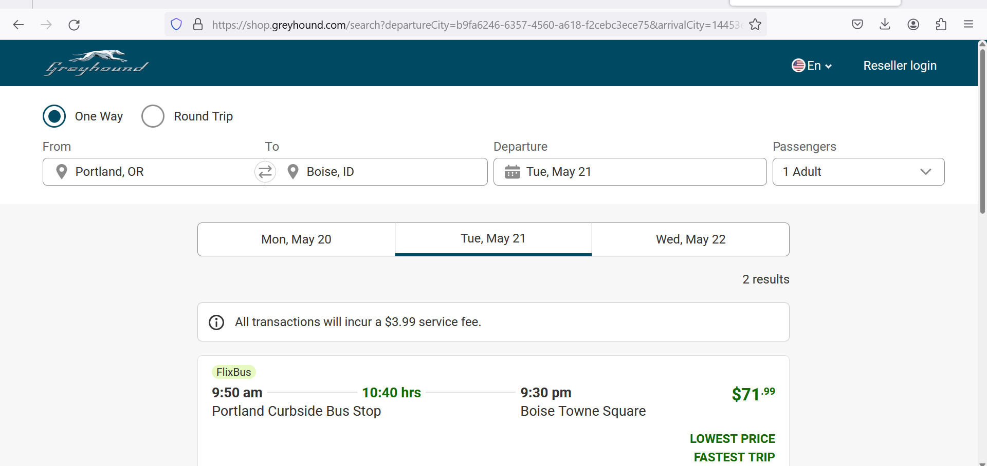
Why pay?

Slide 12
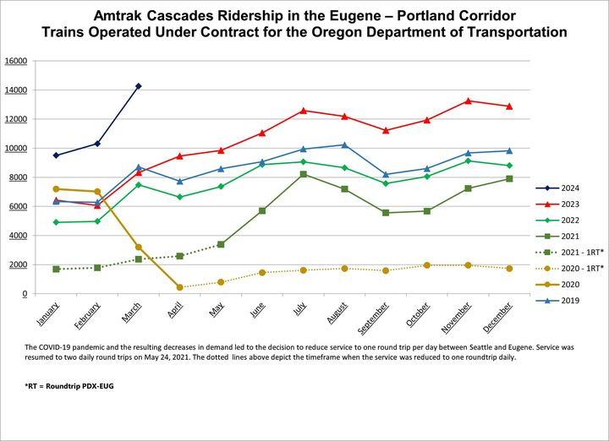
Record Willamette
Valley
Ridership

Slide 13
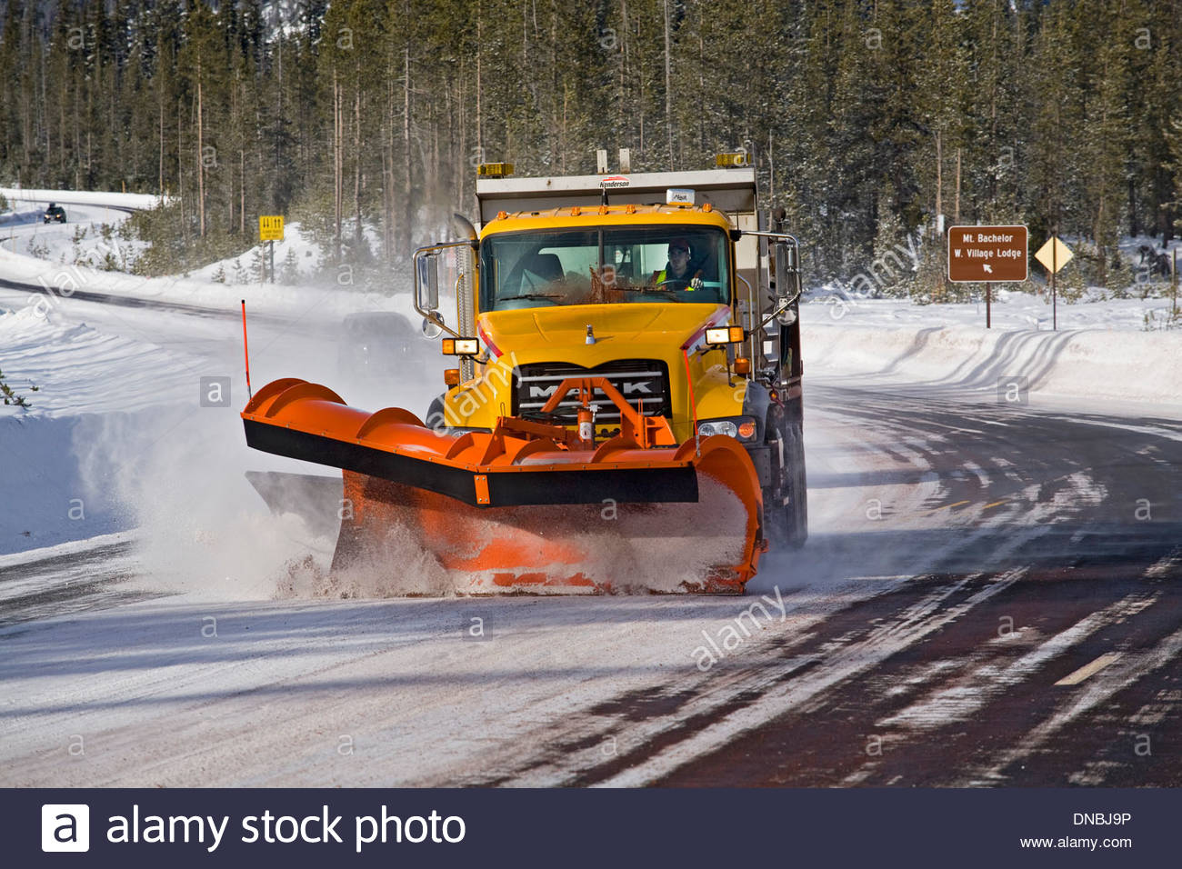
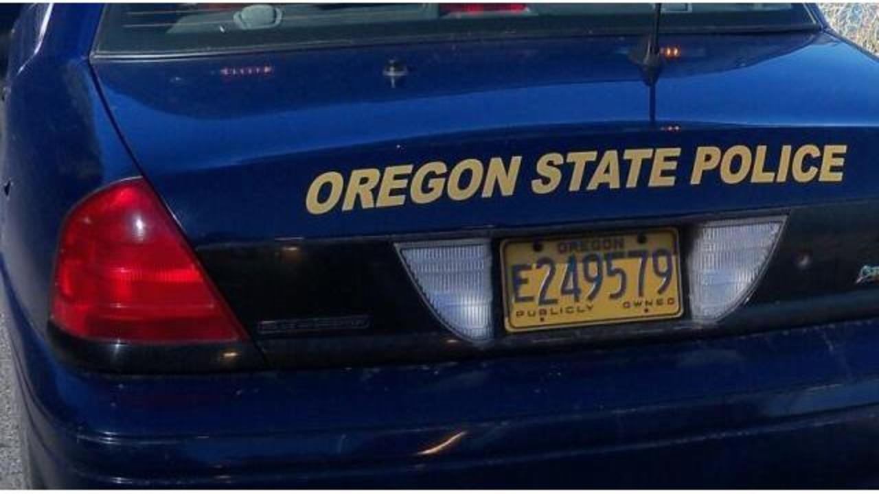
Who pays?

Slide 14

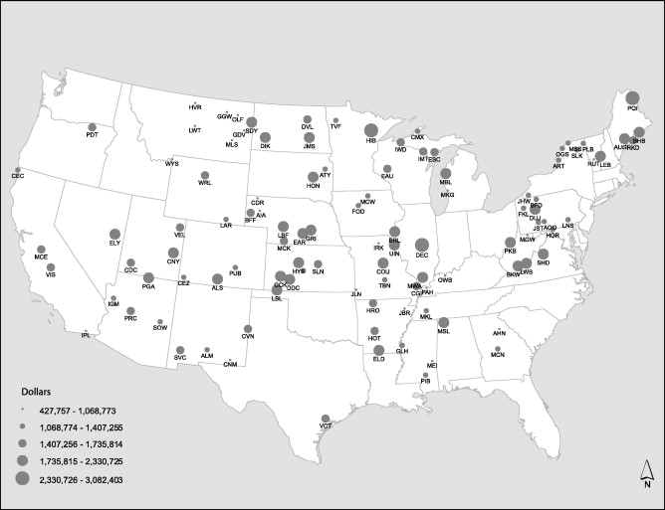
Who pays?

Slide 15
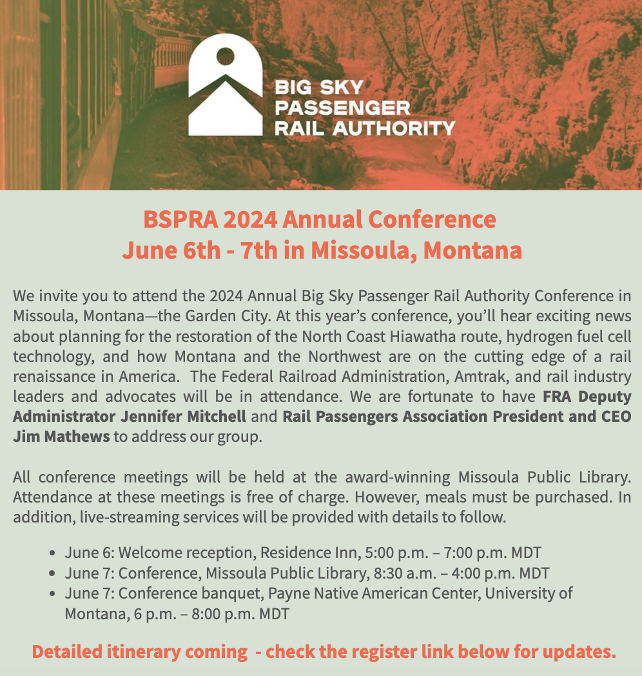
Mark Your Calendar:
June 6-7 in Missoula

Slide 16
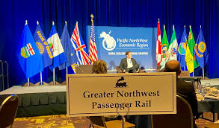
Mark Your Calendar:
Greater NW Rail Summit
October 8-9, Spokane

Slide 17
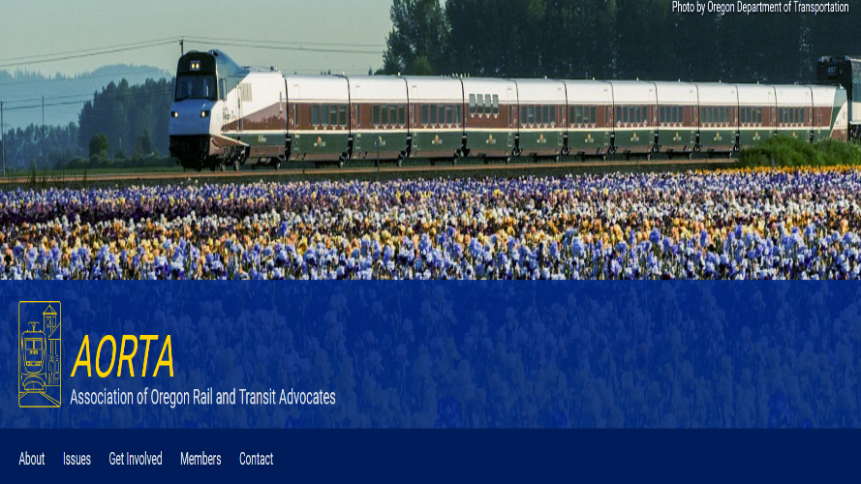
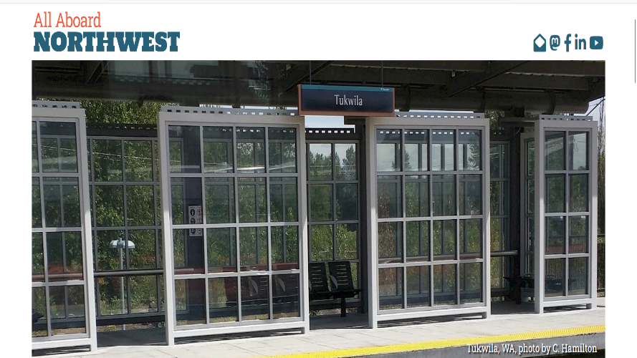
Northwest rail advocacy
www.aortarail.org
www.allaboardnw.org

Slide 18

National advocacy: www.railpassengers.org

